Slide 1



OpenTelemetry Workshop
Gerry Noij & Joris Giesen
Notes:
Welcome
Introduction

Slide 2
Agenda
Observability
OpenTelemetry
SigNoz
Demo
OpenTelemetry Quick Start
Exercises 1 – 4
Spans, attributes, events and baggage
Exercises 5 – 10

Slide 3
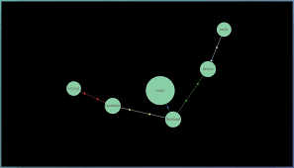
Observability
Observability lets us understand a system from the outside
Notes:
Service map, which shows how different services talk to each other
Observability gives insight in these services, to look from the outside, without knowing the inner workings of these services.
For example, if a request takes a long time, why is that?
Is it a network problem? a slow responding database? May be a bug in the code? Or something else?
Observability of an application tries to give insight into an application to ask questions to get a better understanding of what is going on.

Slide 4
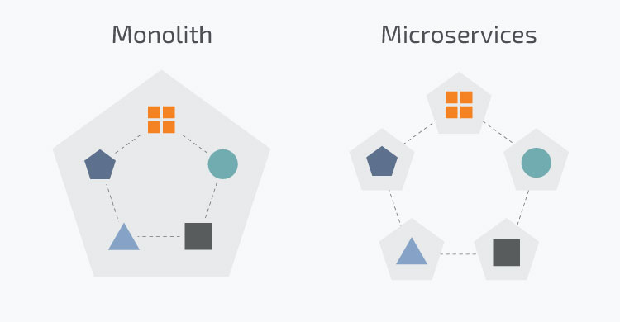
Why is observability important now?
Notes:
Observability was always important, but why is it even more important now?
look at the difference between a monolith and microservice architecture.
Monolith Microservices
- single stack - each its own stack
- easy to debug - debugging much more difficult
which service causes the problem?
Are we going to debug them all or are we going through the logs of each service?

Slide 5
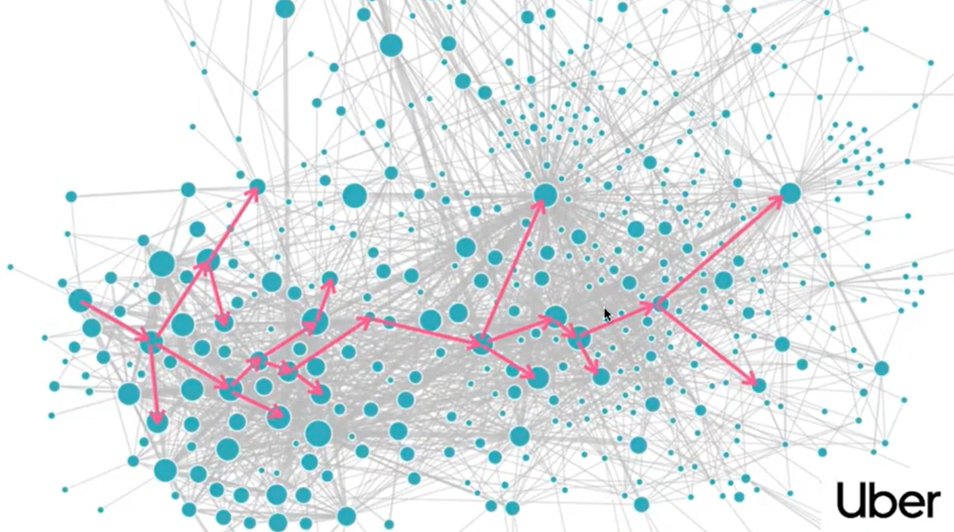
Observability problem with microservices
# microservices increasing
horizontally scalable
upstream or downstream service down
which instance has issues
which deployment version
Notes:
Uber example, one request touches possibly 20 microservices
And from each service there could be multiple instances running. Which instance of which service has a problem?
Is it a upstream or downstream service? A specific instance of a service or may be it is a new version of an existing service, which is rolled out, which has the problem.
There are a lot more possibilities for a problem to occur than with a monolith application.

Slide 6



3 Pillars of Observability
Traces
Metrics
Logs
Context
Notes:
Traces - trace a request across the software stack
basic terms are trace id or span (or spanid)
span is individual event
Metrics – aggregates, latency, error rate
counting number of requests
average time of requests
% of errors
Logs - important events during the execution of code
application logs, etc
unstructured, text based
difficult to go through 100s of 1000s lines of code
Other telemetry data consists of user activity, call stacks, custom protocols
Independently they are less usable than in context with each other

Slide 7
Why one system for observability?
One standard
Vendor agnostic
Easier to learn
Notes:
One system for all these data, which makes it easier to relate the data to each other to make the bug hunting a lot easier.
All their own kind of protocol, and frameworks to use in the application, which you all have to learn to be able to generate the telemetry data.
It would be a lot nicer if there was just one standard, one protocol and framework to learn, to be able to generate all this data. In stead of three different kinds of frameworks.
That standard is here now!

Slide 8
OpenTelemetry
Observability framework
Part of the Cloud Native Computing Foundation (CNCF)
Set of tools, SDKs and APIs
Uses semantic conventions
Generate telemetry data (traces, metrics and logs)
Part of the MicroProfile Specification
Notes:
OpenTelemetry is an observability framework
Part of the Cloud Native Computing Foundation
2nd most biggest and most active project in de CNCF portfolio, Kubernetes is the number one.
It is a set of tools, SDKs and APIs for generating telemetry data (like traces, metrics and logs), using semantic conventions
Semantic conventions is a common naming scheme that can be standardized across a code base, libraries and platforms
It generates telemetry data like traces, metrics and logs
Is part of the MicroProfile Specification, so supported by Application Servers like Quarkus and Open Liberty,

Slide 9
OpenTelemetry - key features
Traces, metrics and logs
Drop in instrumentation
Language
Libraries
Open Source, vendor agnostic
Instruments the original code
Notes:
Key features of OpenTelemetry
Support for traces, metrics and logs
Drop in instrumentation supports
popular languages like
Java, Javascript, C#, C++, Go, Python, etc
popular frameworks & libraries, like
Spring and Spring Boot, MicroProfile (Quarkus, Open Liberty, etc.), JDBC, Kafka, etc
>>> Show instrumentation page

Slide 10
OpenTelemetry Signals
Traces
Metrics
Logs
Baggage
Notes:
OpenTelemetry uses signals to refer to a category of telemetry
The categories are:
Traces
give us the big picture of what happens when a request is made to an application.
traces are essential to understanding the full “path” a request takes in your application.
Metrics
A metric is a measurement of a service captured at runtime.
Application and request metrics are important indicators of availability and performance.
Logs
For example System and application logs
Everything that is not a trace or a metric is considered a log
Baggage
In OpenTelemetry, Baggage is contextual information (in key value pairs) that’s passed between spans.
.

Slide 11
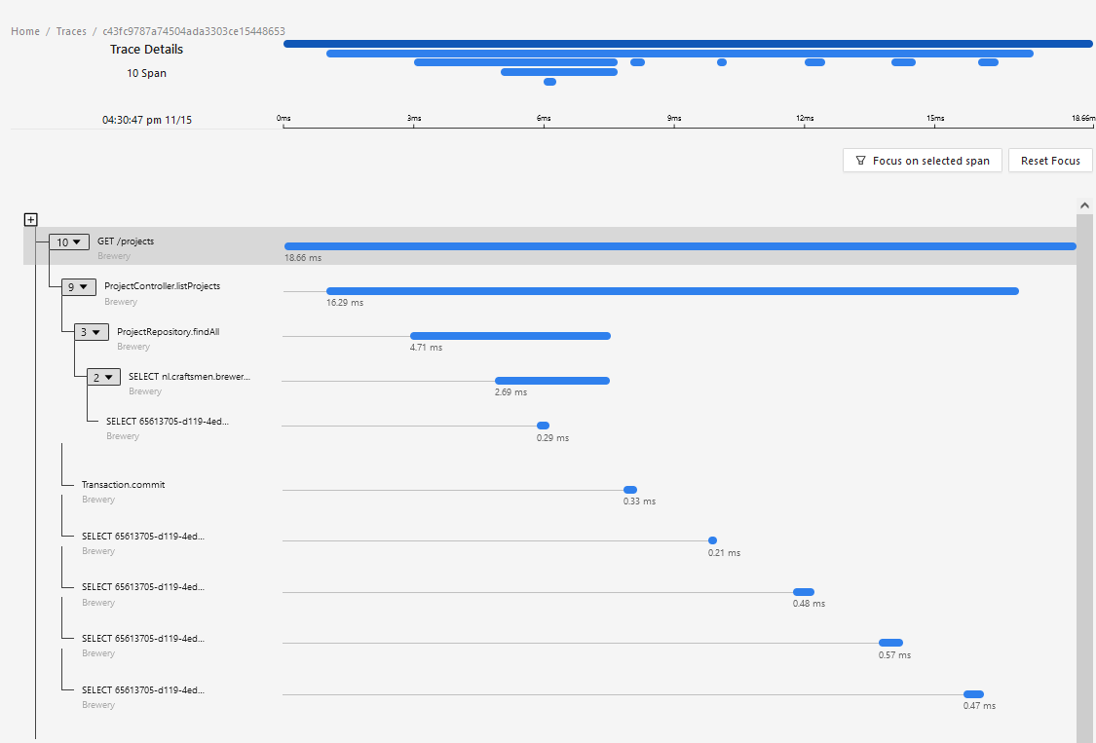
OpenTelemetry - Traces
Notes:
Here you see an example of a trace
A trace is a end-to-end request and consists of spans
A span is a unit of work or operation
Further in the workshop described more in detail

Slide 12
OpenTelemetry - Metrics
Metric instruments
Counter
Gauge
Histogram
Aggregations
Views
Notes:
In OpenTelemetry measurements are captured by metric instruments.
Metric instruments are:
Various kinds of counters: value that acummulates over time
Gauge: Measures a current value at the time it is read
Histogram: A client-side aggregation of values, such as request latencies.
Aggregation:
Combining a large number of measurements about metric events over a time window
Duration of a system call, Cpu or memory usage, Etc.
A view provides SDK users with the flexibility to customize the metrics output by the SDK.

Slide 13
OpenTelemetry Collector
Receivers
receives data and transforms to OTLP
Jaeger, Kafka, OTLP, Prometheus, Zipkin, etc.
Processors
processes the OTLP data
drop samples, add labels, filters
Exporters
exports the data to
Jaeger, Kafka, OTLP, Prometheus, Zipkin, logging, etc.
Notes:
So how does it all work?
It consists of receivers, processors and exporters.
Configured with YAML files, which tells the collector how to receive the data, to process it and export it to various formats.
Show YAML file SigNoz
OpenTelemetry does not have its own backend, so uses other tools, like
Jaeger for tracing,
Prometheus/Grafana for metrics
Elasticsearch for logs
Some tools have all-in one, like Datadog or Dynatrace, but they are not free, and have vendor lock in.
So we use SigNoz for our workshop

Slide 14
SigNoz
Metrics + Traces in a single pane
Powerful trace filtering attributes
Out of the box SaaS solutions
Support for OLAP data stores (Clickhouse)
Can be run in your own cloud
Notes:
SigNoz offers an all in one solution

Slide 15
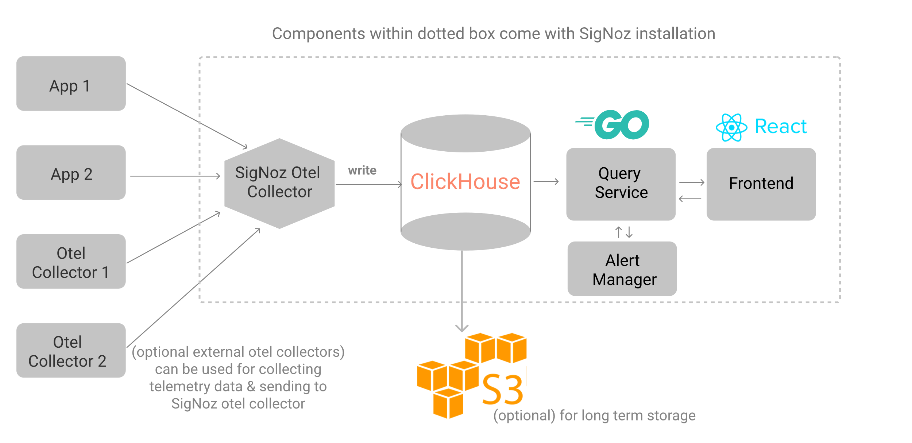
SigNoz architecture
Notes:
Apps or other OTEL collectors send data to the SigNoz OTEL collector
The collector writes data to a ClickHouse OLAP database (Online analytical processing
This data can be stored in an S3 bucket for long time storage
The front end uses a query service to send requests to the database
You can add some alerts when a threshold is met

Slide 16

Notes:
The workshop is not about SigNoz. We just use it as the user interface to show the traces, metrics and log.

Slide 17
OpenTelemetry Quick start
Automatic instrumentation
Manual instrumentation
Notes:
If you want to start with OpenTelemetry in your application, you can choose either for automatic configuration, manual configuration or a mix of these two.
Automatic configuration uses a java agent and with manual configuration, adding some dependencies is enough to see some tracing in the backend.

Slide 18
OpenTelemetry - Automatic instrumentation
Uses a java agent jar
On startup:
java -javaagent:path/to/opentelemetry-javaagent.jar
-Dotel.service.name=your-service-name -jar myapp.jar
Via JAVA_TOOLS_OPTIONS
export JAVA_TOOL_OPTIONS="-javaagent:path/to/opentelemetry-javaagent.jar"
export OTEL_SERVICE_NAME="your-service-name"
java -jar myapp.jar
https://opentelemetry.io/docs/zero-code/java/agent/
Notes:
auto instrumentation, using a java agent to run your application
picks all traces from standard libraries,
whole range, like jdbc, kafka, etc.
set system properties or environment variables and call application

Slide 19
OpenTelemetry – Automatic instrumentation configuration
system properties
otel.service.name=your-service-name
otel.traces.exporter=otlp
otel.exporter.otlp.endpoint=http://localhost:4317
environment variables
OTEL_SERVICE_NAME=your-service-name
OTEL_TRACES_EXPORTER=otlp
OTEL_EXPORTER_OTLP_ENDPOINT=http://localhost:4317
Configuration file with properties
otel.javaagent.configuration-file=path-to-file
https://opentelemetry.io/docs/zero-code/java/agent/configuration/
Notes:
For configuration of the java agent you can use either
system properties or
environment variables, or
A configuration file
Typical properties to set are
Service name
type of exporter (i.e. OTLP, Jaeger, Zipkin, etc.)
Endpoints of collector
4317 = gRPC port
4318 = HTTP port
For more information see the documentation

Slide 20
OpenTelemetry - Manual instrumentation
Add OpenTelemetry dependencies to the application
Spring Boot
<dependency> <groupId>io.opentelemetry.instrumentation</groupId> <artifactId>opentelemetry-spring-boot-starter</artifactId> </dependency>
https://opentelemetry.io/docs/zero-code/java/spring-boot-starter/
Quarkus
<dependency> <groupId>io.quarkus</groupId> <artifactId>quarkus-opentelemetry</artifactId> </dependency>
https://quarkus.io/guides/opentelemetry
Notes:
To start with manual instrumentation you need to add dependencies.
In this workshop we will use
Spring Boot and
Quarkus implementations of OpenTelemetry
Spring Boot
There is a spring-boot-starter instrumentation library, which needs additional configuration for, for example, the jdbc instrumentation which isn’t trivial.
Therefore, for this workshop, we will use the MicroMeter libraries (which is the Spring Boot 3 implementation of Spring Sleuth)
Quarkus
Quarkus is a MicroProfile implemention
OpenTelemetry is part of the MicroProfile Specification
So the quarkus-opentelemetry jar is a MicroProfile implementation of OpenTelemetry

Slide 21
MicroMeter dependencies
org.springframework.boot:spring-boot-starter-actuator
io.micrometer:micrometer-tracing
io.micrometer:micrometer-registry-otlp io.micrometer:micrometer-tracing-bridge-otel
io.opentelemetry:opentelemetry-exporter-otlp
https://docs.micrometer.io/micrometer/reference/
https://docs.spring.io/spring-boot/docs/current/reference/htmlsingle/#actuator.micrometer-tracing
Notes:
For OpenTelemetry with Micrometer we need the following dependencies
Spring Boot Actuator
Micrometer tracing
MicroMeter Registry OTLP
MicroMeter Tracing Bridge OTEL
OpenTelemetry Exporter OTLP
Since Spring Boot uses a sampling rate of 0.1 (1 in every 10 requests is send to the exporter), we need to set the sampling rate to 1.0 to trace every request in de OpenTelemetry backend

Slide 22
OpenTelemetry - Database instrumentation
Spring Boot
Either use the standard OpenTelemetry JDBC instrumentation library, or the MicroMeter instrumentation
net.ttddyy.observation:datasource-micrometer-spring-boot:1.0.2
Quarkus
For Quarkus you can use the standard OTLP JDBC instrumentation library
io.opentelemetry.instrumentation:opentelemetry-jdbc
https://github.com/open-telemetry/opentelemetry-java-instrumentation/tree/main/instrumentation/jdbc/library
https://quarkus.io/guides/opentelemetry#jdbc
Notes:
You can use either the OpenTelemetry JDBC instrumentation with some extra configuration
like manually create your datasource with an OpenTelemetry wrapper
Or use a MicroMeter jdbc instrumentation
For Quarkus we only need the standard OpenTelemetry JDBC instrumentation
We only need to switch it on by setting an application property
quarkus.datasource.jdbc.telemetry=true

Slide 23
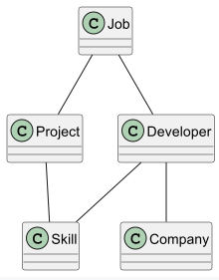
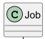
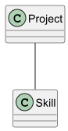
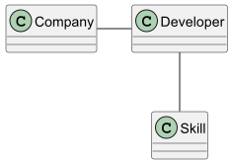
Exercises – IT Brewery application
Exercises 1 – 3
Exercises 4 - end
Notes:
The application is a kind of Spring Pet Clinic, but instead of pets we use the IT Brewery as the use case
The first three assignments uses a single application
The next assignments use microservices in three applications

Slide 24
Assignments 1 - 4
Git clone https://gitlab.com/craftsmen/opentelemetry-workshop.git
Follow the installation instructions in Installation.md
Start with the assignments 1 -4 in Assignments.md
If you cannot install SigNoz,
Set the OTEL exporter to http://<ip address>:4317 (ip address will be provided)
The SigNoz UI is on http://<ip address>:3301
Hints: every assignment contains hints (at the end)

Slide 25
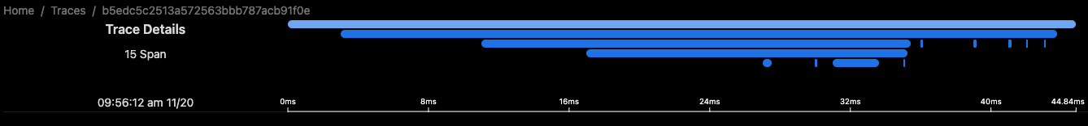
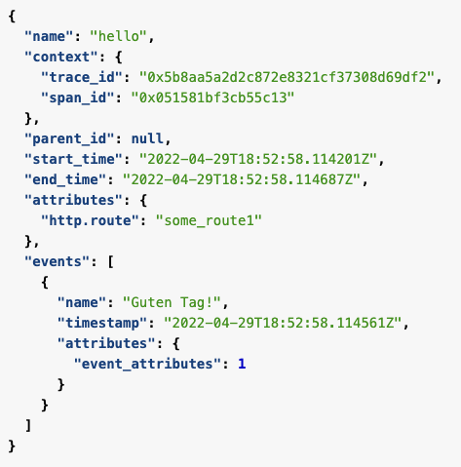
OpenTelemetry - Traces
To get the bigger picture
Notes:
Traces give us the big picture of what happens when a request is made to an application.
Monolith or sophisticated mesh of services
Understanding the full “path” of a request
For a request a “parent span” is created, which gets a unique trace id, with some other attributes
A trace consists of one or more (probably more) spans.

Slide 26
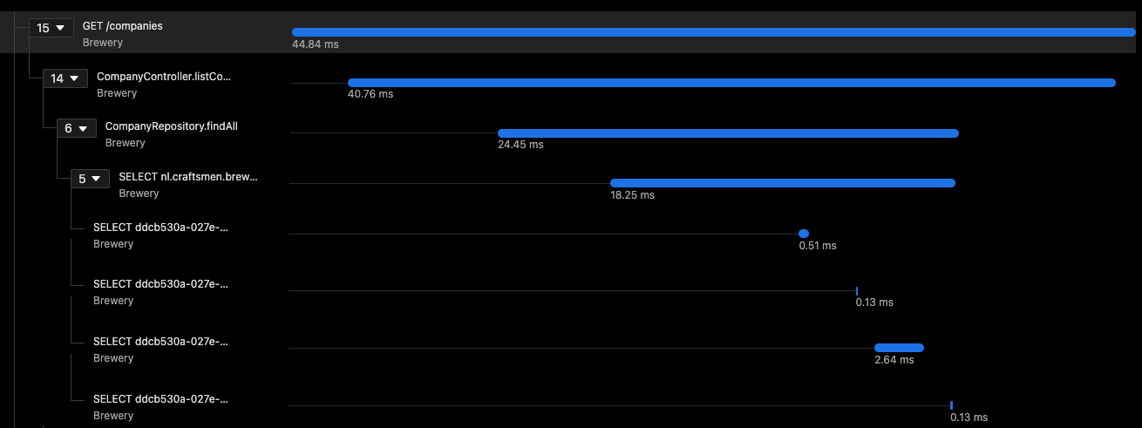
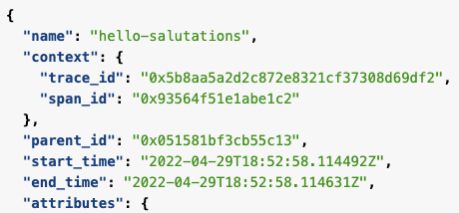
OpenTelemetry - Spans
Parts of the bigger picture
Notes:
A span represents a unit of work or operation.
It has the following properties:
- name
- parent span id (or empty for root spans)
- start and end timestamps
- context
- attributes
- events
- links
- status

Slide 27
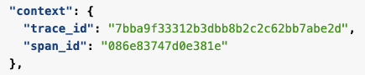
OpenTelemetry - Span Context
Details of a unit of work
Notes:
Context is immutable
- trace id
- span id
- trace flags (a binary encoding containing information about the trace); TraceFlags.SAMPLED : TraceFlags.UNSAMPLED; Indicating if span will be sampled or not
- trace state (experimental); could be used for making recording decissions for specific implementations
- ot=p:8;r:62
- specs: The tracestate field is designed to handle the variety of techniques for making recording decisions (or other specific information) specific for a given vendor.

Slide 28
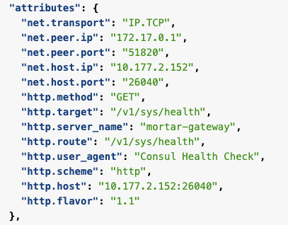
OpenTelemetry - Span Attributes
Attributes of a unit of work
https://opentelemetry.io/docs/specs/semconv/general/trace/
Notes:
key-value pairs that contain (non-null) metadata
Example:
- service specific header values
- user id
- product id, which you add to shopping cart
For common scenario naming conventions: see link

Slide 29
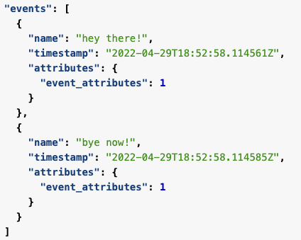
OpenTelemetry - Span Events
Annotations of a unit of work
Notes:
Can be thought of as a structured log message (or annotation) on a Span
- span is best to track an operation with start and end time, and event to track a singular point in time within a span
- can contain one or more attributes

Slide 30
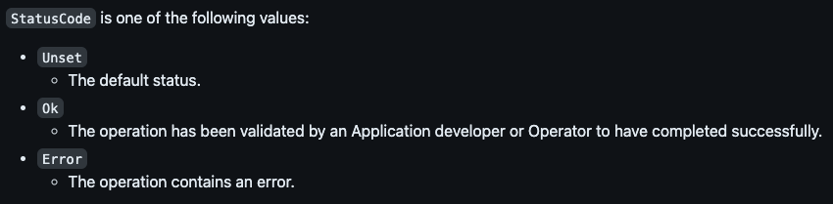
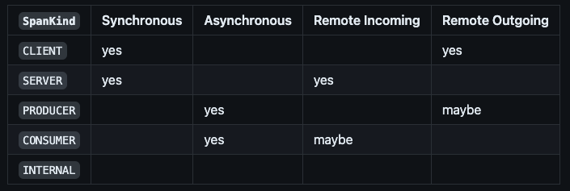
OpenTelemetry - Span Status & Kind
Status and type of unit of work
Notes:
Set a span status when there is a known error in the application code
- Unset (default
- Ok (do not set in own application)
- Error (on exception handling)
Set to Error when an exception has occurred ans is caught, leave in Unset otherwise (backend will set a final status)
KIND:
SERVER indicates processing of CLIENT request (SERVER child of CLIENT)
CLIENT indicates sending request to remote service (CLIENT parent of SERVER)
PRODUCER (initiator of async. request)
CONSUMER (receiver of async. request)
INTERNAL (internal application logic; default)

Slide 31
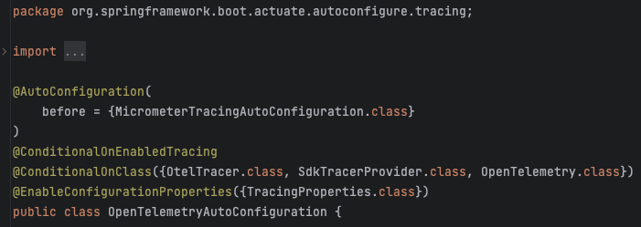
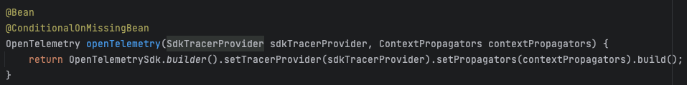
OpenTelemetry – Tracing in Spring Framework
Example in real life
Notes:
- Spring Actuator dependency provides OpenTelemetry beans
- openTelemetry
- tracer (name “org.springframework.boot“ and spring boot version)

Slide 32
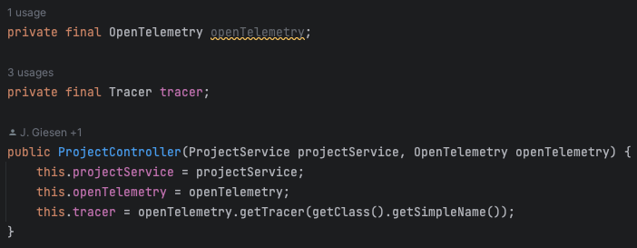
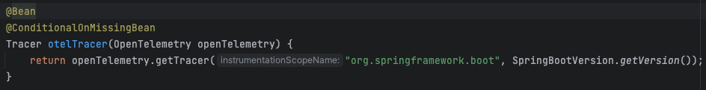
OpenTelemetry – Tracing in Spring Framework
Example in real life
Notes:
You can create own tracer, but much simpeler to use the existing one.

Slide 33
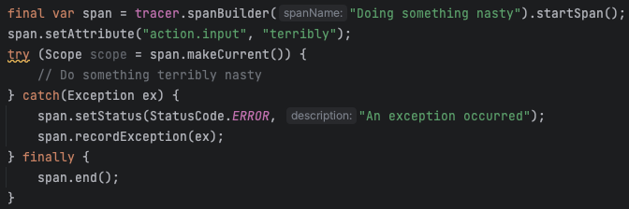
OpenTelemetry – Tracing in Spring Framework
Example in real life
Notes:
Try with resources: Scope is AutoCloseable
“makeCurrent” adds this ImplicitContextKeyed value to the current context and makes the new Context the current context. Scope.close() must be called to properly restore the previous context from before this scope of execution… or context will not work correctly. It is recommended to use try-with-resources to call Scope.close() automatically.

Slide 34
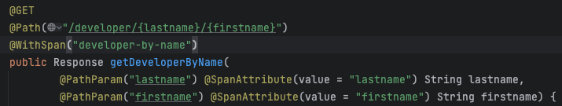
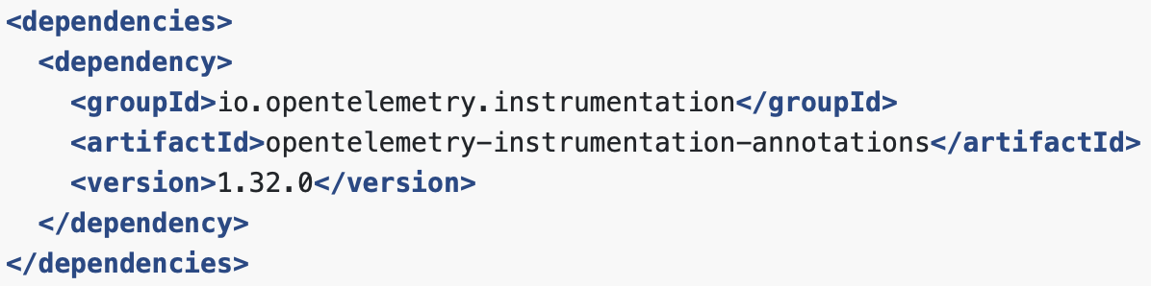
OpenTelemetry – Tracing in Quarkus
Example in real life
Notes:
Quarkus library “quarkus-opentelemetry“ includes the instrumentation annotations library (should also work for Spring)

Slide 35
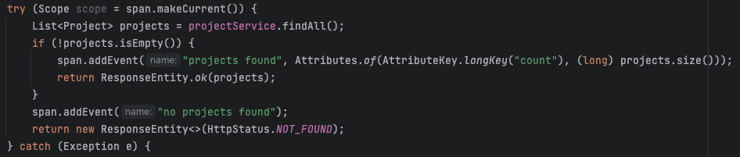
OpenTelemetry – Span Events
Example in real life

Slide 36
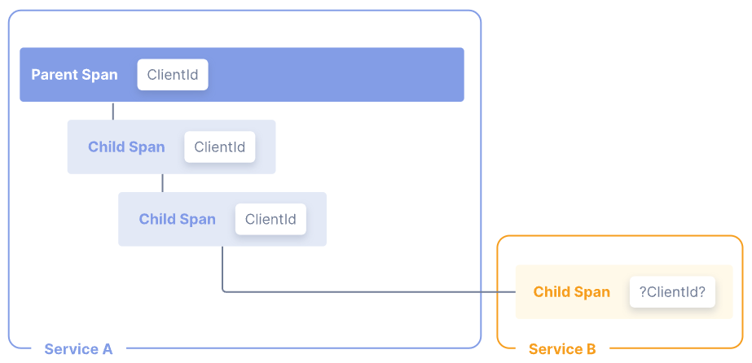
OpenTelemetry - Baggage
Contextual information across spans
Notes:
- bound to a trace
- passed between spans
- key-value store that resides alongside span context in a trace
- Do not confuse with span attributes
- Baggage does not automatically end up as attributes of child span.
- passed to child rest api
- cannot get attributes of parent span

Slide 37
OpenTelemetry – Baggage
Example in real life

Slide 38
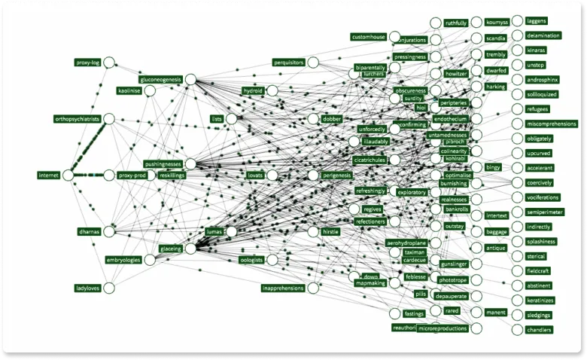
OpenTelemetry – Distributed Tracing
Context across spans
Notes:
a.k.a Context Propagation
Using Propagators to (de)serialize cross-cutting concern values: SpanContext and Baggage.
Tracing across service can be done by using the “traceparent” request header
Baggage uses request header to propagate value to remote services. (vuln. To man-in-middle attack)
Use RestTemplateBuilder to create a RestTemplate

Slide 39
Thank you
Gerry Noij & Joris Giesen

